Slide 1
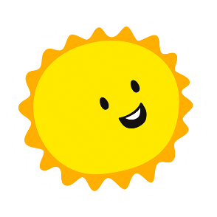


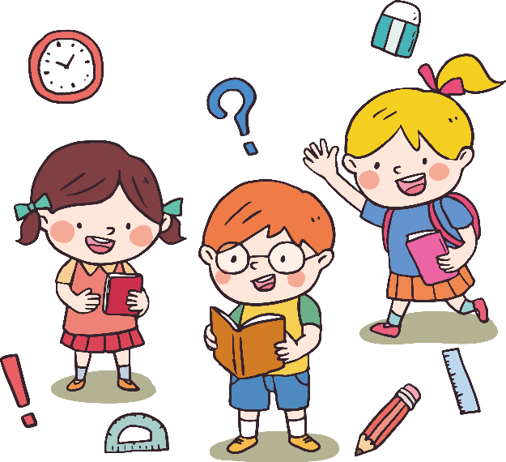
FAMILY and FRIENDS 1
National Edition

Slide 2
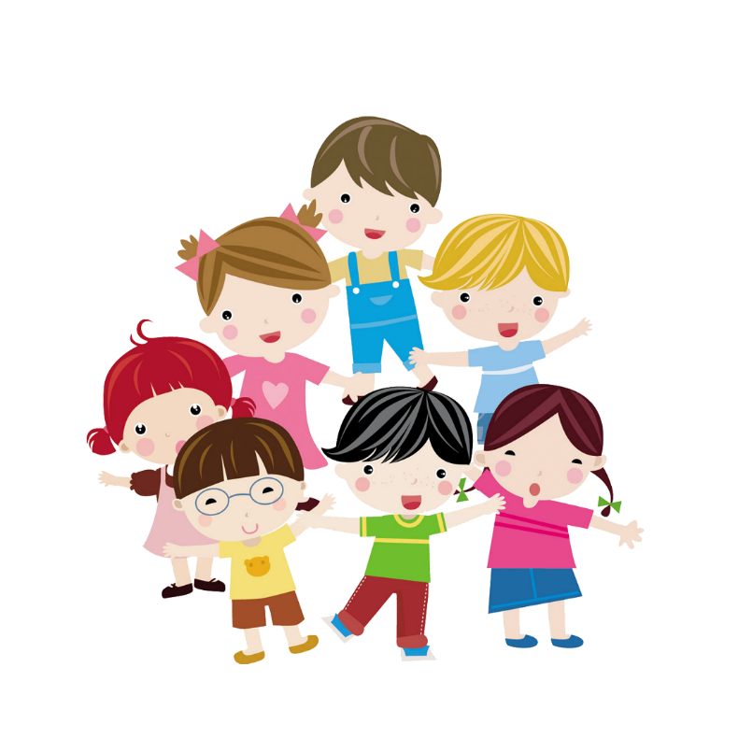
UNIT 2 : WHAT’S THIS ?
Lesson 1 : Words

Slide 3
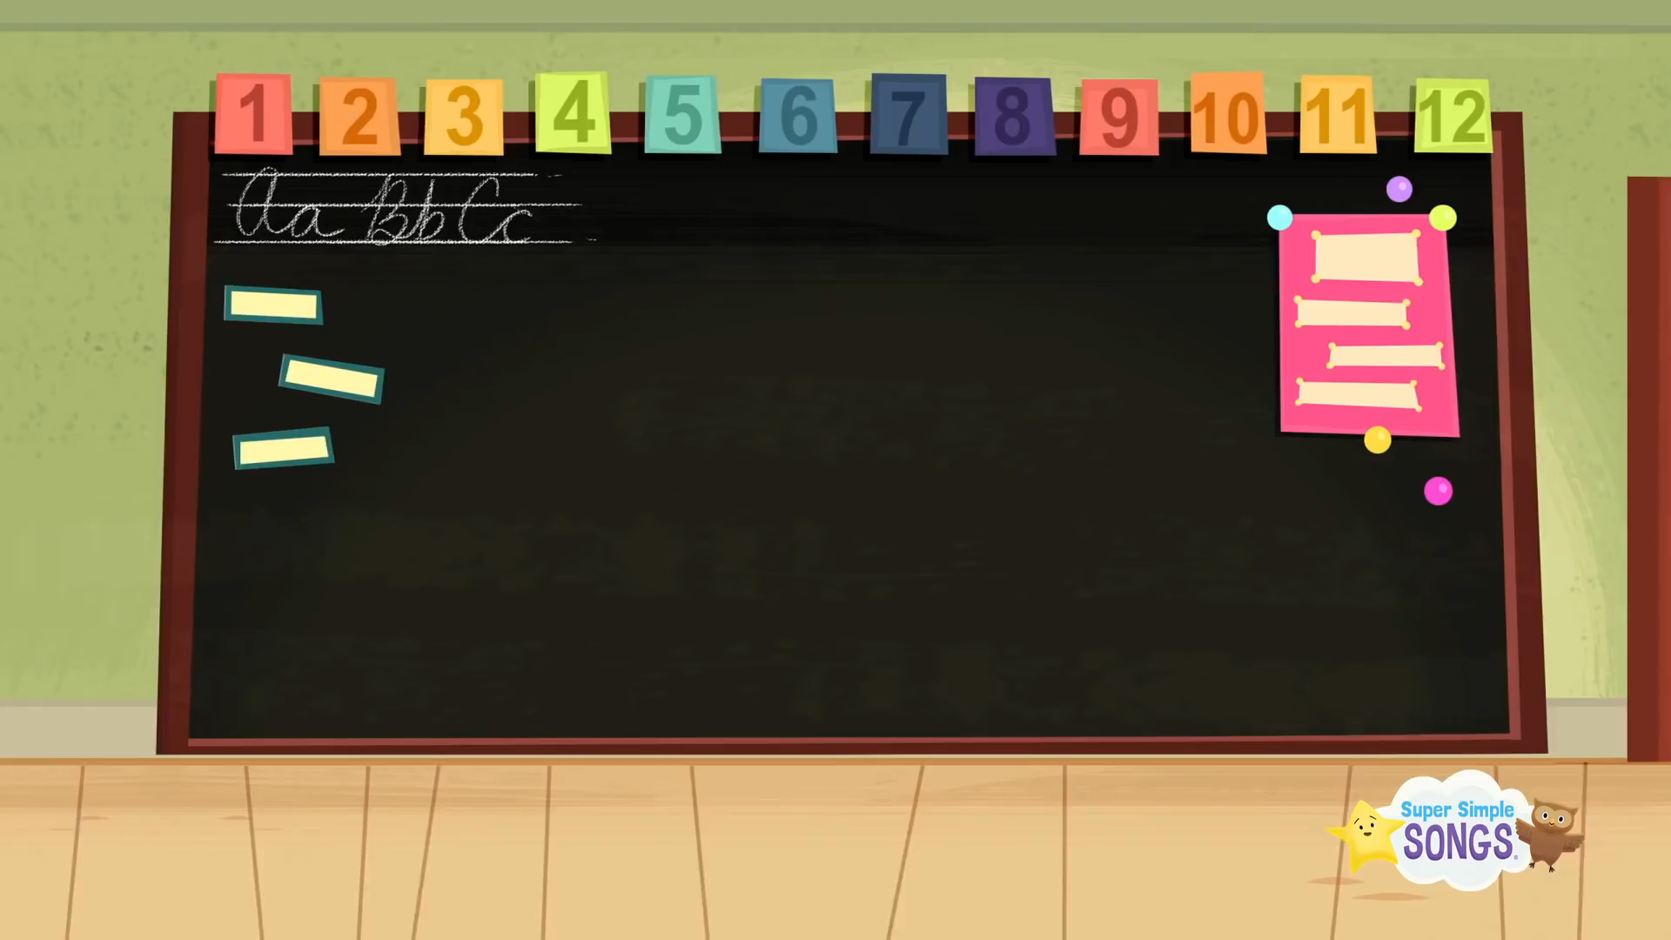
bbbbcvvgggpooggg

Slide 4

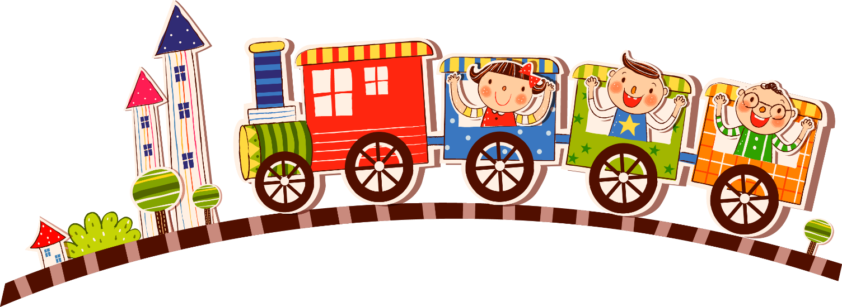
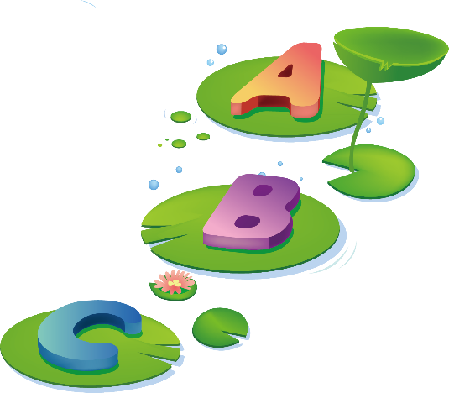
What color
is it ?

Slide 5

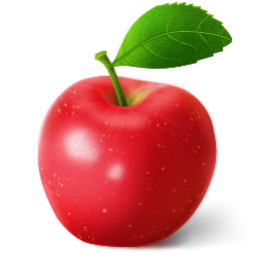
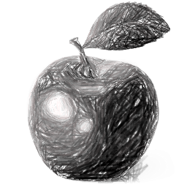


Choose the right color

Slide 6
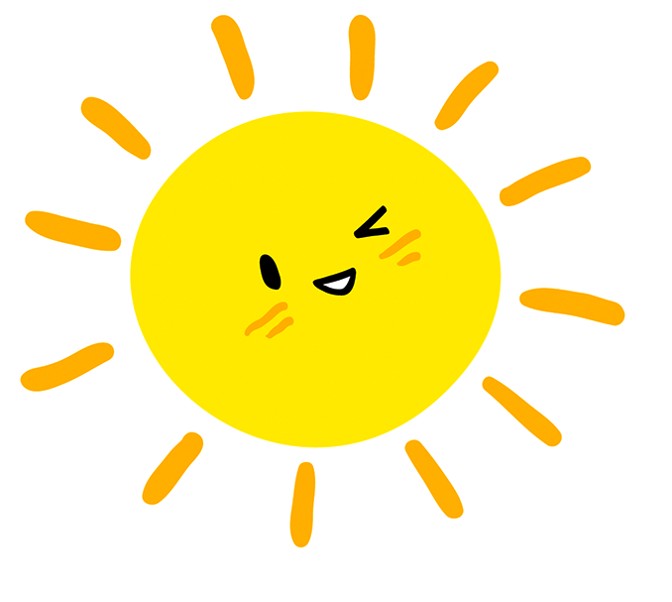
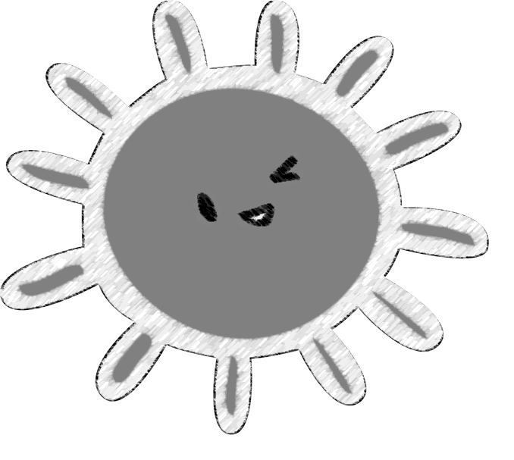
Choose the right color

Slide 7
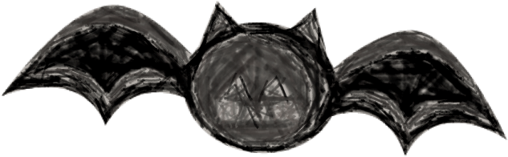

Choose the right color

Slide 8
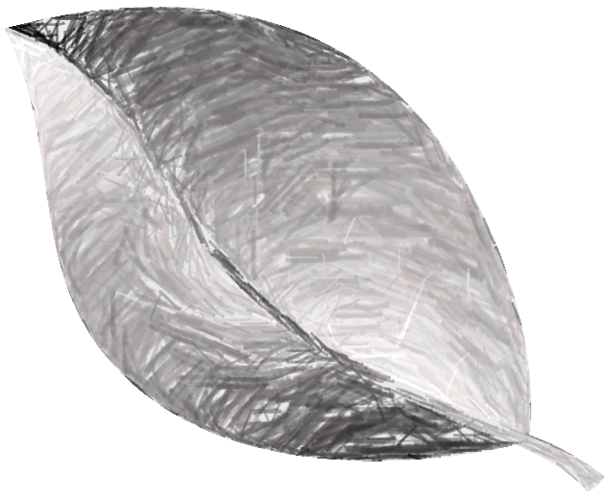

Choose the right color

Slide 9

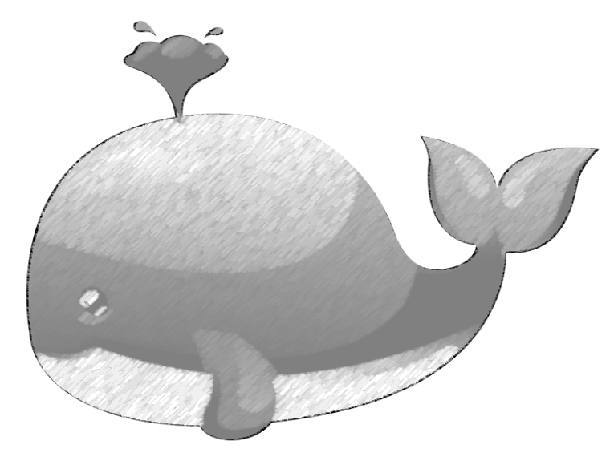
Choose the right color

Slide 10


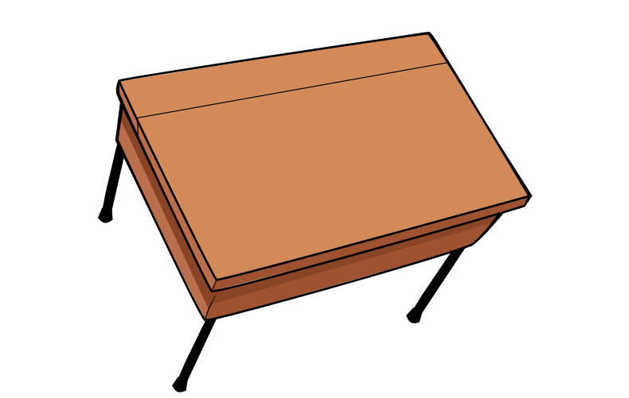

Notes:
- Ask: What’s this?
- Say: It’s a desk.
- Ask students to repeat the word desk.
- Repeat the same steps for chair, crayon, pencil, notebook.

Slide 11
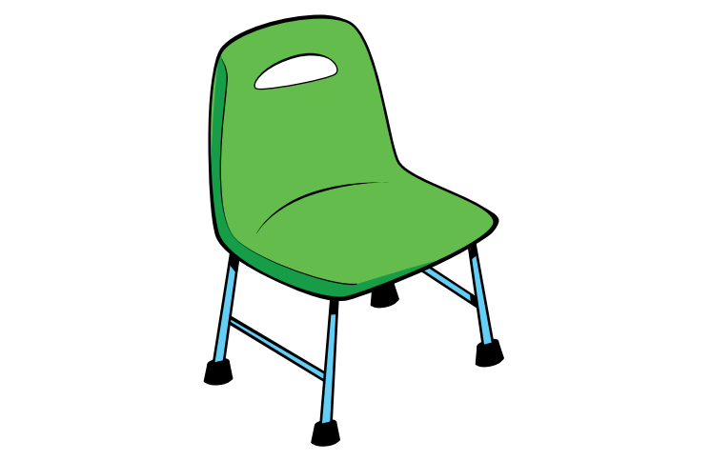

Slide 12


Slide 13
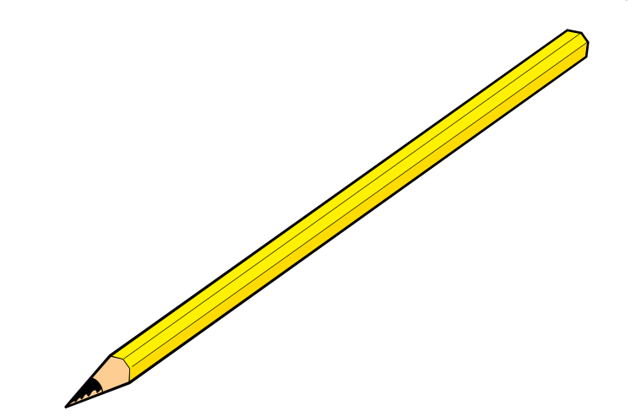

Slide 14
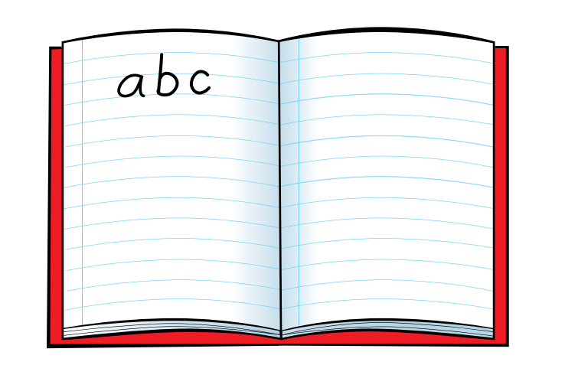

Slide 15


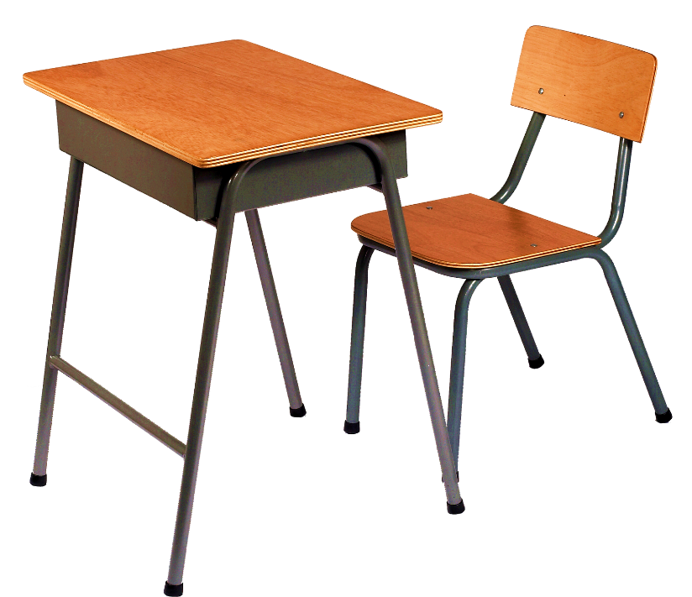

Notes:
Listen and repeat again

Slide 16
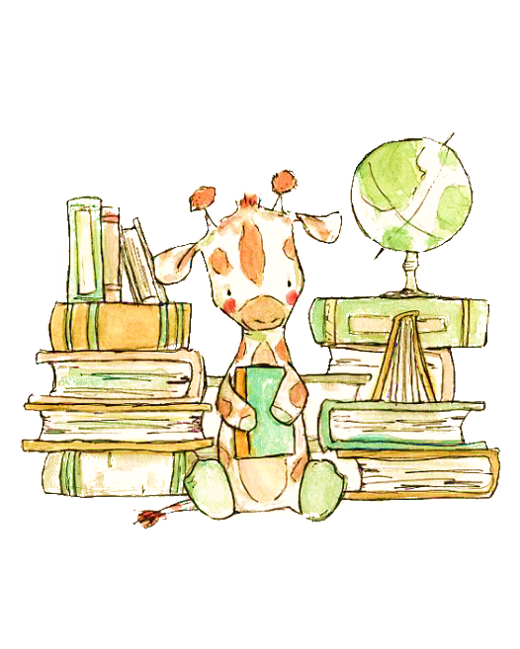
Notes:
Listen and point. Track 26
- Play the track 26, listen and point
- Play again, ask students to listen and point
- Play again, ask students to listen and repeat

Slide 17
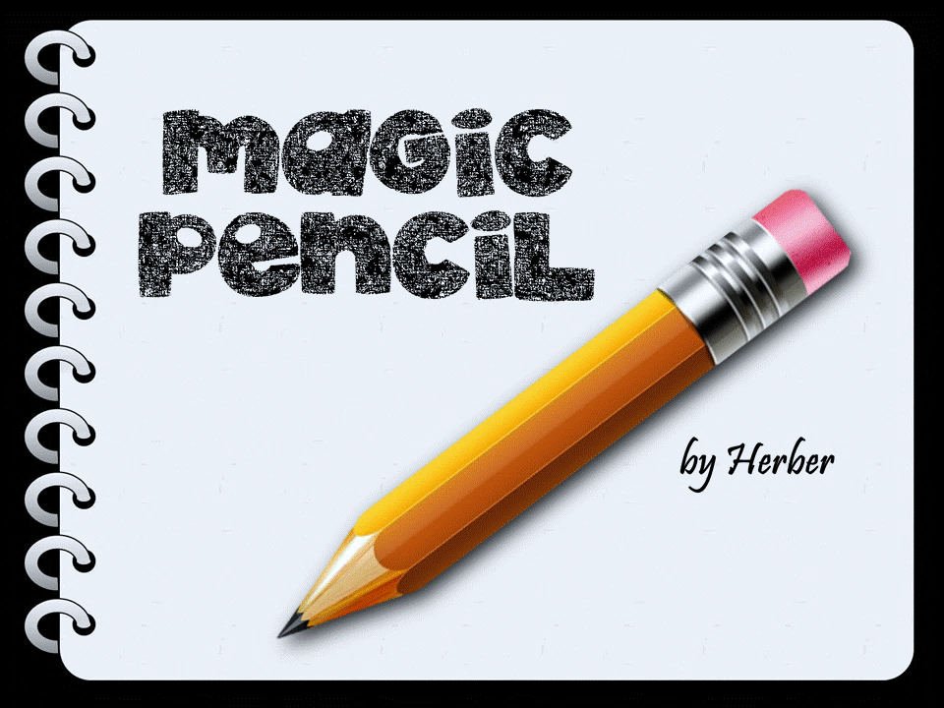

School things
START

Slide 18

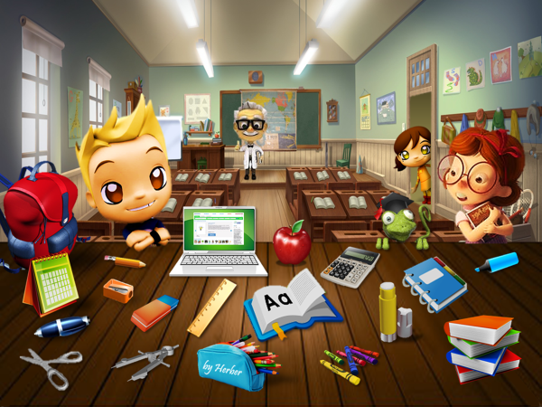




What is this? It’s a …
pen
marker
pencil

Slide 19
What is this? It’s a …
pencils
crayons
markers

Slide 20
What is this? It’s a …
notebook
diary
book

Slide 21
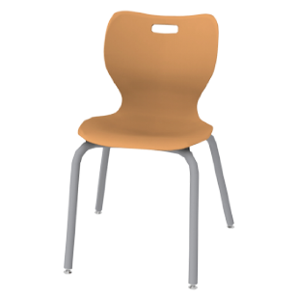
What is this? It’s a …
pen
ruler
chair

Slide 22
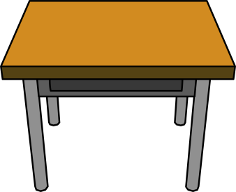
What is this? It’s a …
pencils
desk
markers

Slide 23
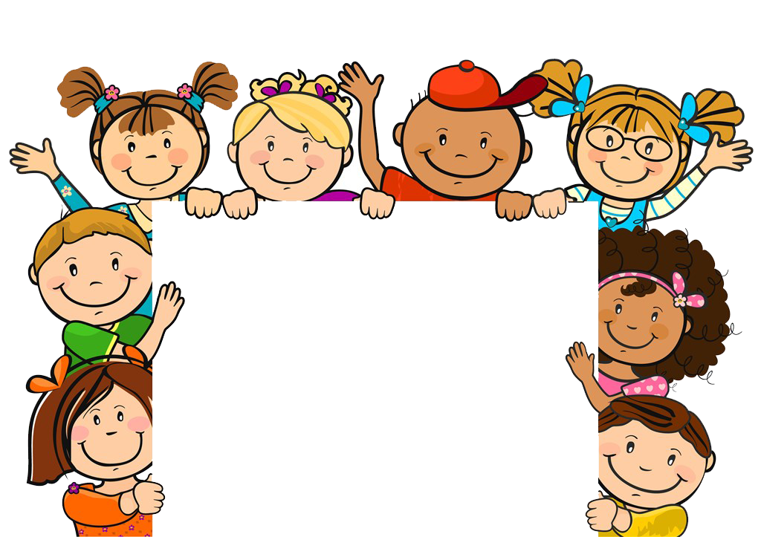
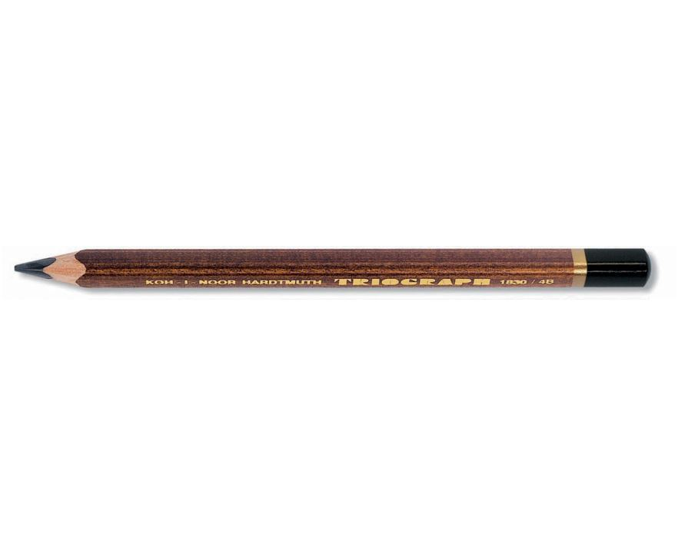

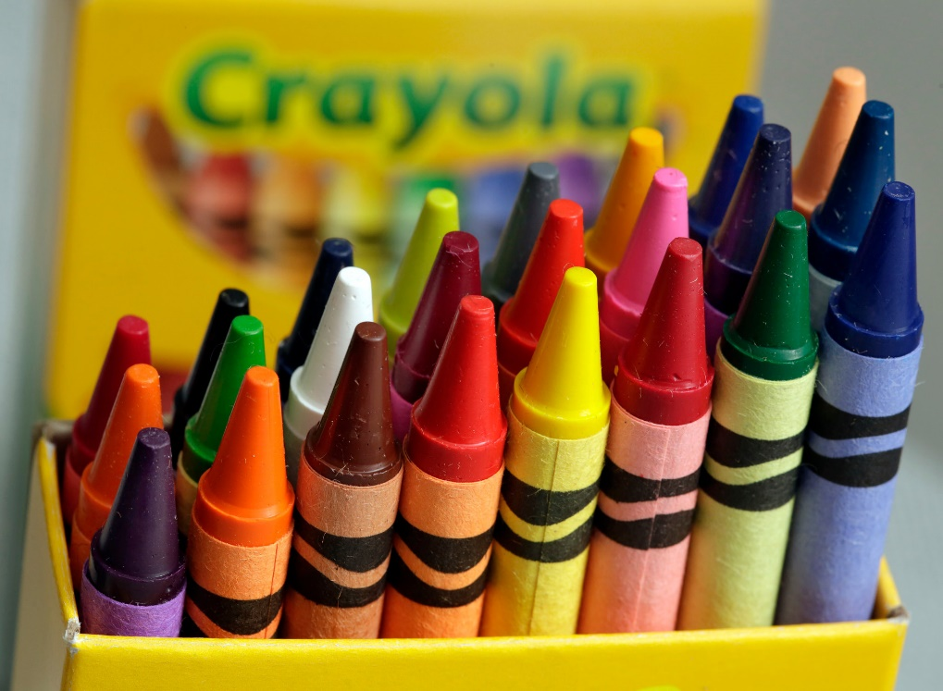
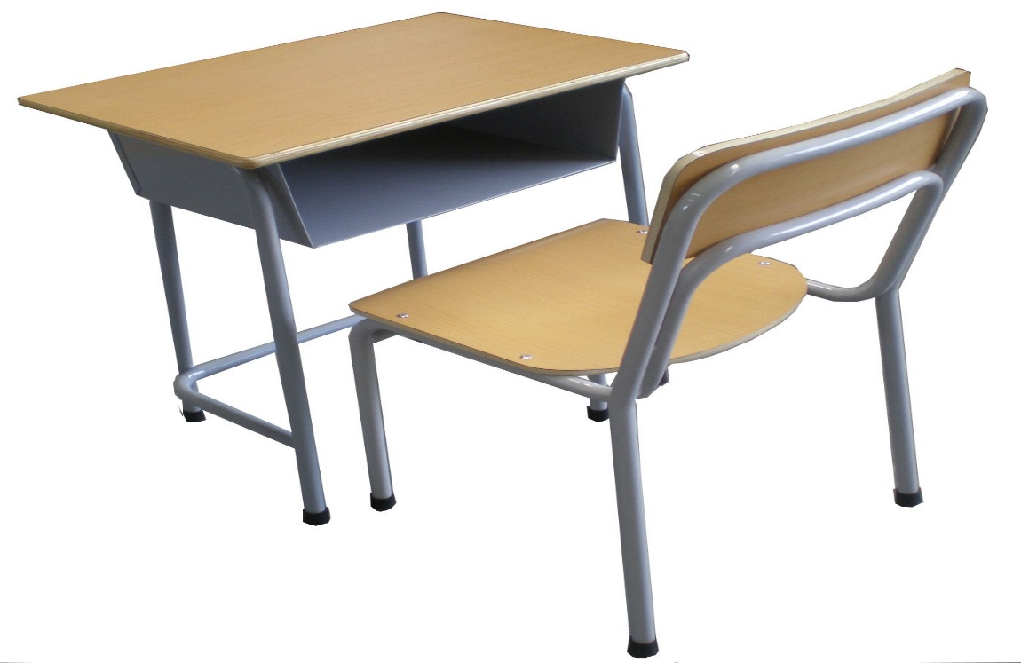
Listen & chant
Notes:
Listen and chant. Track 26
- Students listen to track 26
- Divide the class into 5 groups
- Give each group a flashcard
- Play the chant again
- Students listen and stand up when they hear their group’s school word
- Students listen and chant along
• Below level: Ask students to hold up, or point to, the correct classroom object when they hear their word in the chant.
• At level:
Divide the class into 5 groups
Each group is given a card
Play the chant
Student listen, hold up their pictures and stand up to say aloud
• Above level:
Students practice the chant and the actions described together, so that the children try to do all the actions for the chant, not just one.

Slide 24
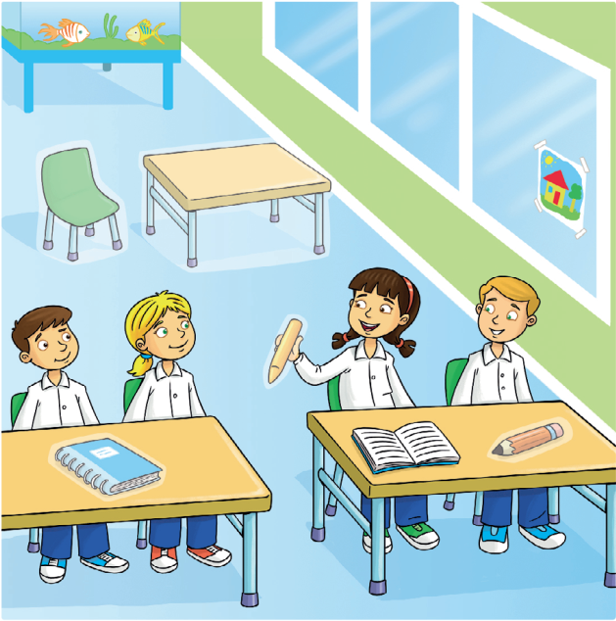
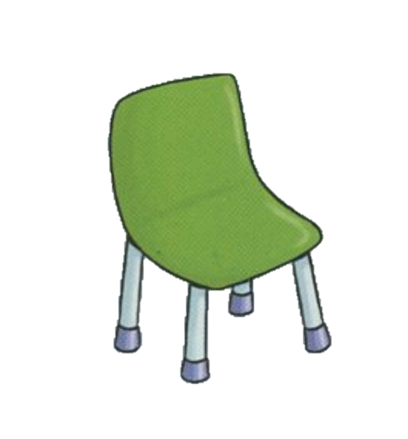
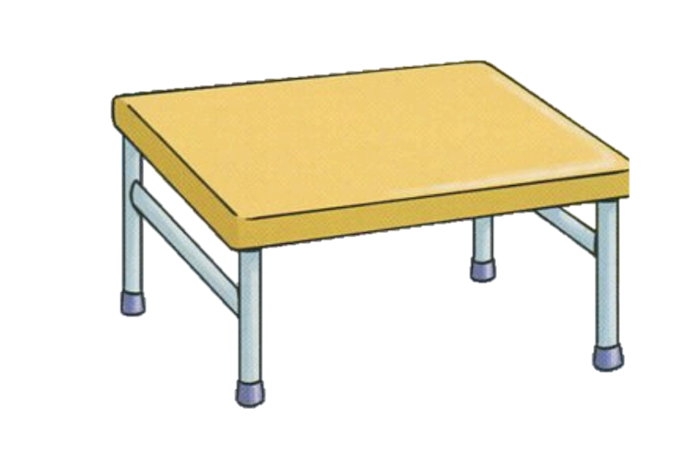
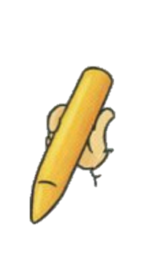
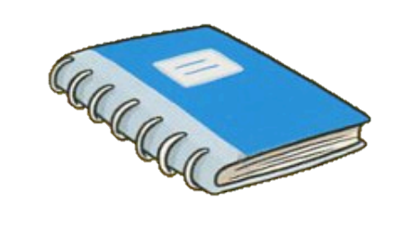
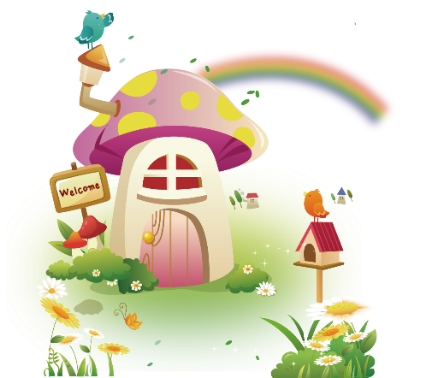
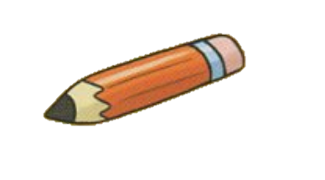
Notes:
Point and say. Stick
- Show students how to do:
point to the classroom objects in the picture
say: ” Let’s stick!”
stick the sticker and say: “CRAYON”
- Ask students to work in pairs to say and stick
- Go around to help

Slide 25

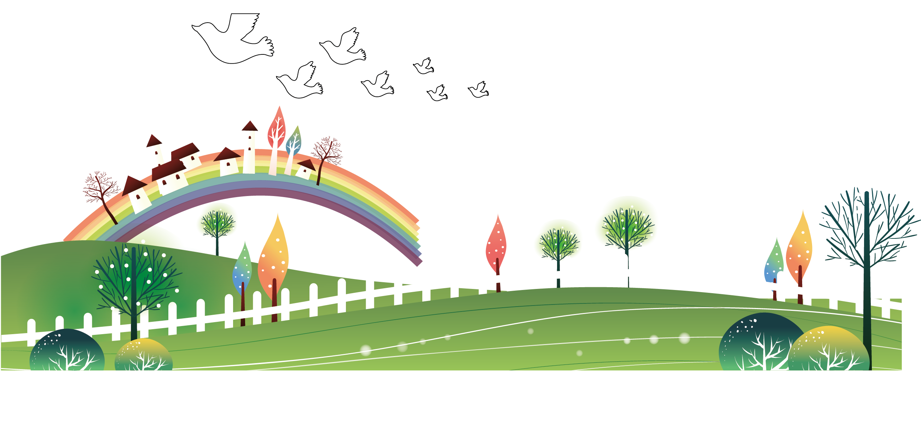
Thank You
Goodbye !

